Slide 1
IS 607 Final Project
Understanding the underlying factors behind Internet Adoption
Adam Stopek
December 18th 2014

Slide 2
Introduction
Internet is a great educational tool that allows people from around the globe communicate and collaborate.
According to internet.org 85% of the world is within reach of physically being able to connect to the internet but only 35% does.
Why is there this gap?

Slide 3
Project Outline
Understand Internet adoption rates by discovering some features that explain why some countries have different levels.
Scrape the internet for said features and massage data in R to make it useable.
Data exploration and cross correlations.
Build a predictive model to explain internet adoption rates
Visualize the results

Slide 4
Feature Selection
Features chosen were:
literacy rate, GDP per capita (in USD), median age, suicide rate, unemployment rate, population density, ratio of males to females, the happy planet index, percent of English speakers, pollution levels, life expectancy
Data was scraped from across different websites, cleansed, and joined into one data set.
One challenge I faced was the fact that I had to use the lowest common denominator of countries because of the join. I was left with less data than I would have liked, but it was nevertheless enough for the analysis.

Slide 5
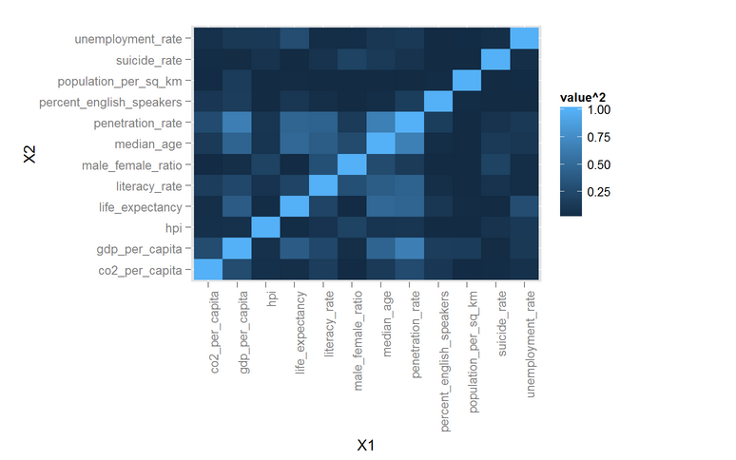
Exploratory Analysis
Began by looking at the descriptive statistics for each variable.
Then I looked at correlations with Internet penetration rates and cross correlations.
Here is a cross correlation heat-map I produced (this visualization something we didn’t cover in class).

Slide 6
Model Building
Separated data into training set and test set
Using linear regression I built a model to predict Internet Penetration Rates based on the features I chose.
Seeing that some of the variables were not significantly contributing to the model I performed a step-wise regression.
Finally I produced a model with an adjusted R-squared of 0.865 (very high)
Features that were kept in the model were: literacy rate, median age, happiness index, percent of English speakers and life expectancy.

Slide 7
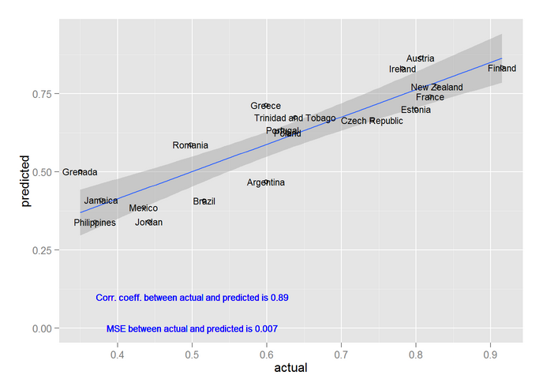
Model Validation
Here is the model validation performed on the test set (30% of the data randomly chosen)
Correlation between actual and predicted is very high and MSE is very low.
Most countries fall within confidence interval

Slide 8
Conclusion
Of the features I looked at, literacy rate, median age, happiness index, percent of English speakers and life expectancy had high predictive value.
While we cannot know whether these are the cause for specific internet penetration rates or the effect, understanding that these factors are very predictive in nature can begin to help us increase internet adoption thus creating a more open and connected world.

